Slide 1
Code Optimization

Slide 2
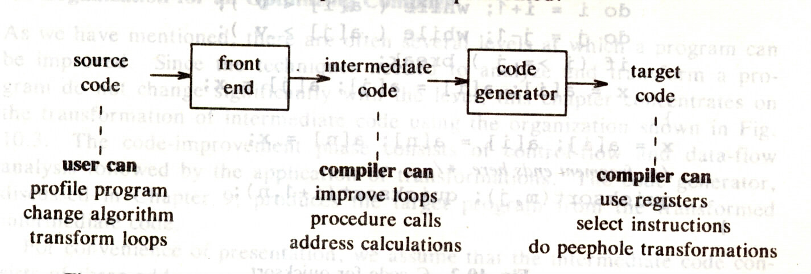
Potential Improvement

Slide 3
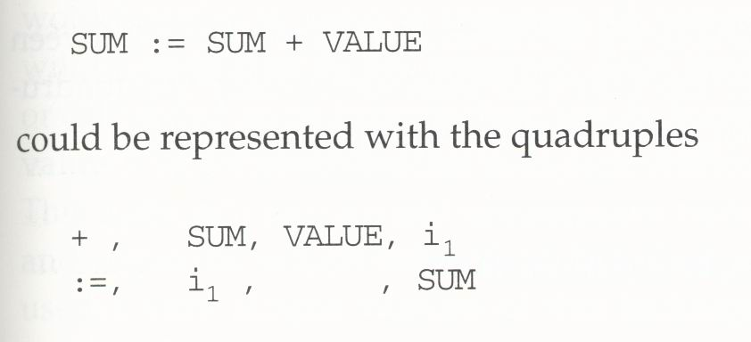
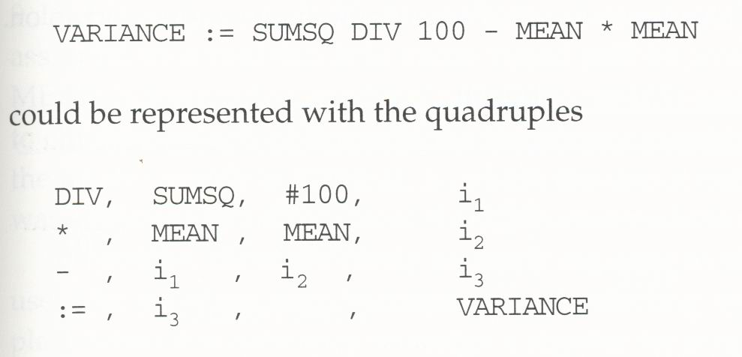
Intermediate Form of the Program
Representation of the executable instructions with a sequence of quadruples:
  operation, op1, op2, result
For example:

Slide 4
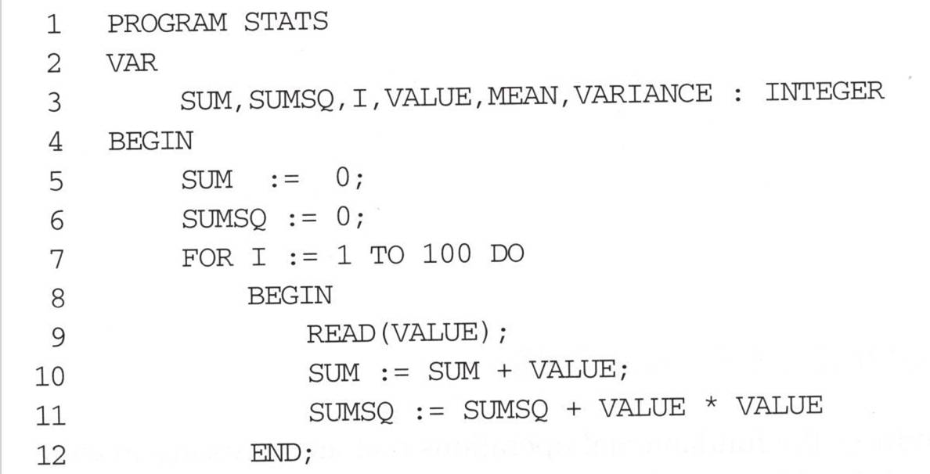
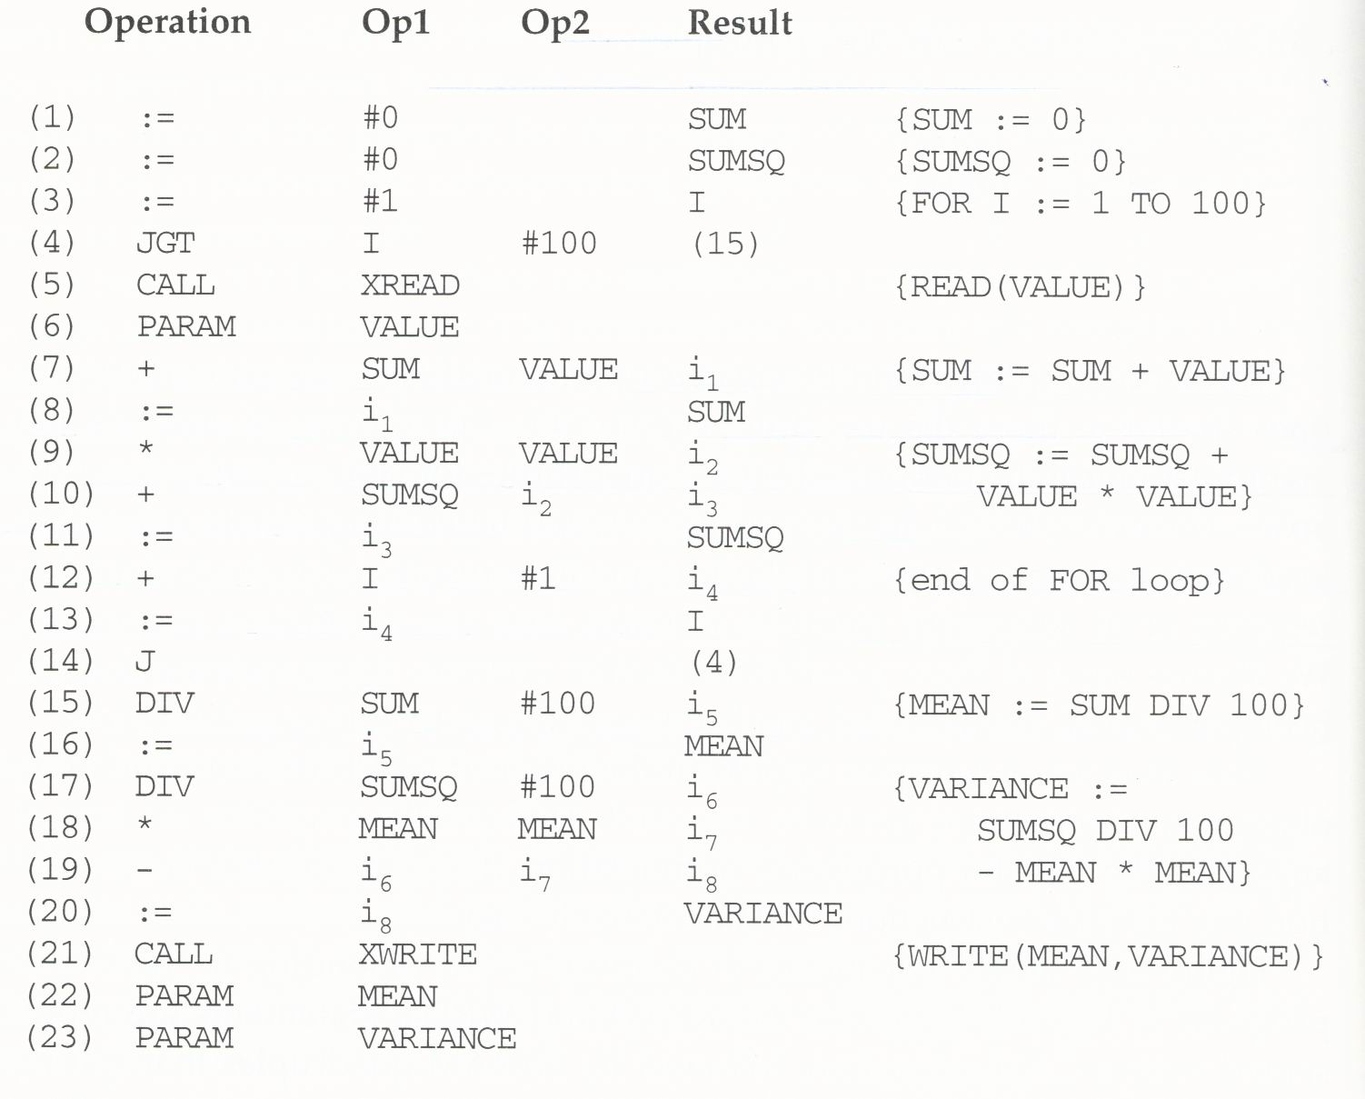
Intermediate Code

Slide 5
Quadruple Analysis for Code Optimization
Intermediate results can be assigned to registers or to temporary variables to make their use as efficient as possible.
Quadruples can be rearranged to eliminate redundant load and store operations.

Slide 6
Assignment and Use of Registers as Instruction Operands
We would prefer to keep in registers all variables and intermediate results that will be used later in the program.
Consider “VALUE” in quadruples 7 and 9, “MEAN” in quadruples 16 and 18.
Register selection for replacement:
  Scan the program for the next point at which each register value would be used.
  Select the one whose value will not be needed for the longest time.
  Save the value of the selected register to a temporary variable if necessary.
Be careful about the control flow of the program when assigning and using registers:
  Consider “SUM” in quadruples 1 and 7.

Slide 7
Basic Blocks
One way to deal with the control flow is to divide the program into basic blocks.
A basic block is a sequence of quadruples with one entry point (beginning of the block), one exit point (end of the block), and no jumps within the block.
Assignment and use of registers within a basic block can follow the method previously described.

Slide 8
Basic Blocks
A
B
C
D
E

Slide 9
Rearrangement of Quadruples
DIV SUMSQ #100 i1
* MEAN MEAN i2
- i1 i2 i3
:= i3 VARIANCE
LDA SUMSQ
DIV #100
STA T1
LDA MEAN
MUL MEAN
STA T2
LDA T1
SUB T2
STA VARIANCE
* MEAN MEAN i2
DIV SUMSQ #100 i1
- i1 i2 i3
:= i3 VARIANCE
LDA MEAN
MUL MEAN
STA T1
LDA SUMSQ
DIV #100
SUB T1
STA VARIANCE

Slide 10
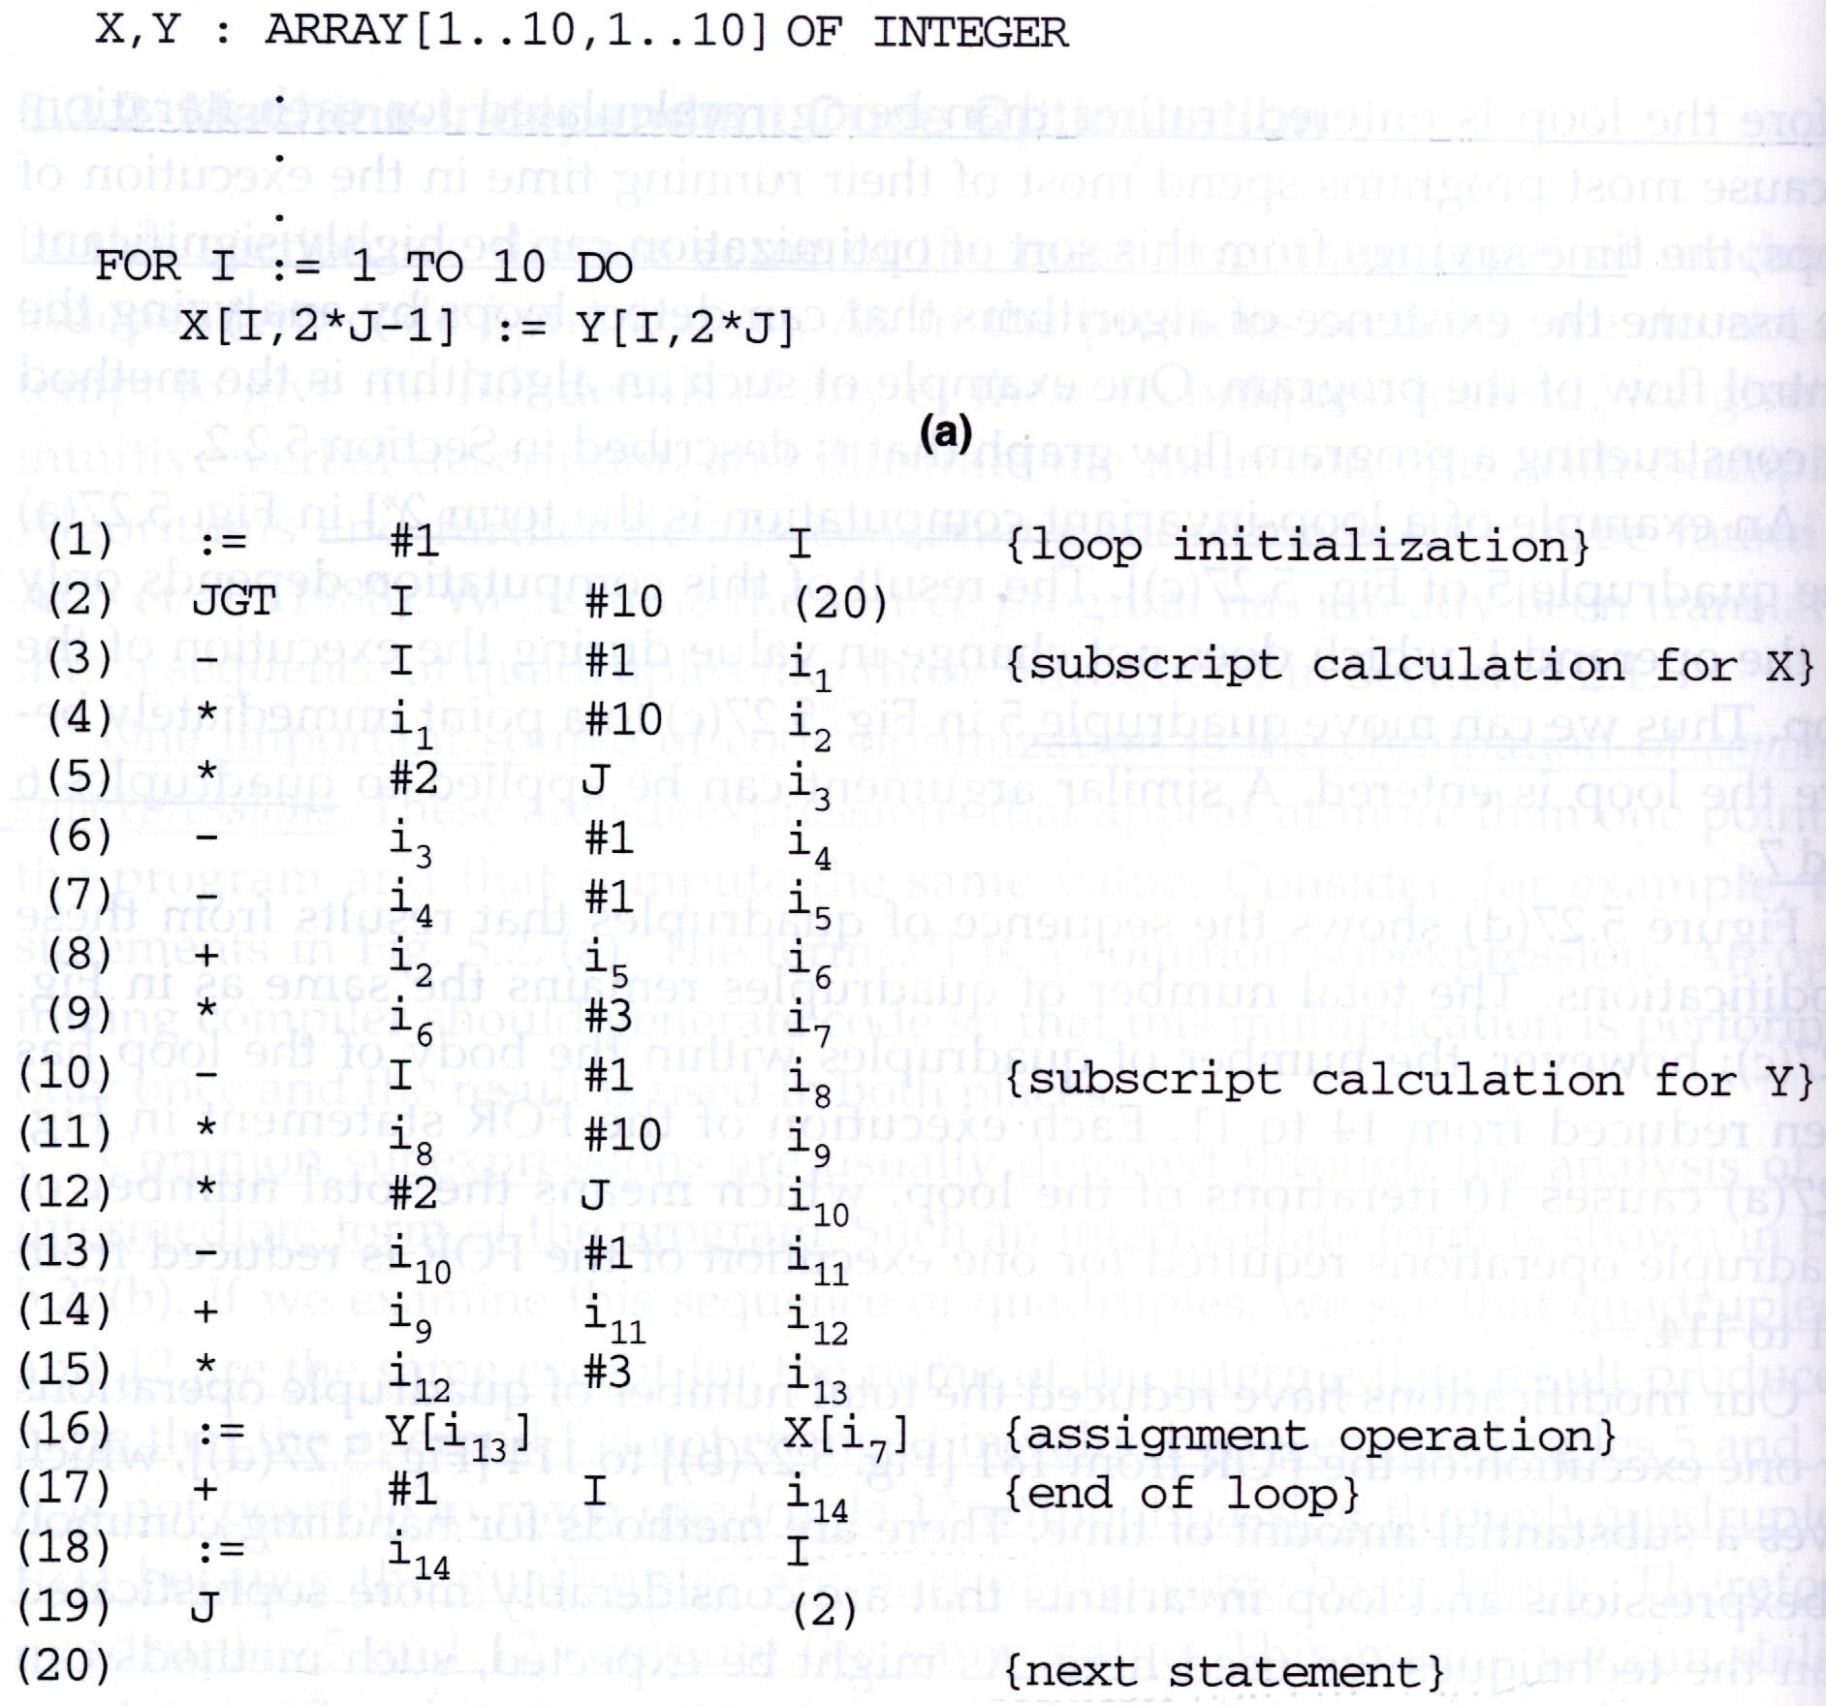

Slide 11
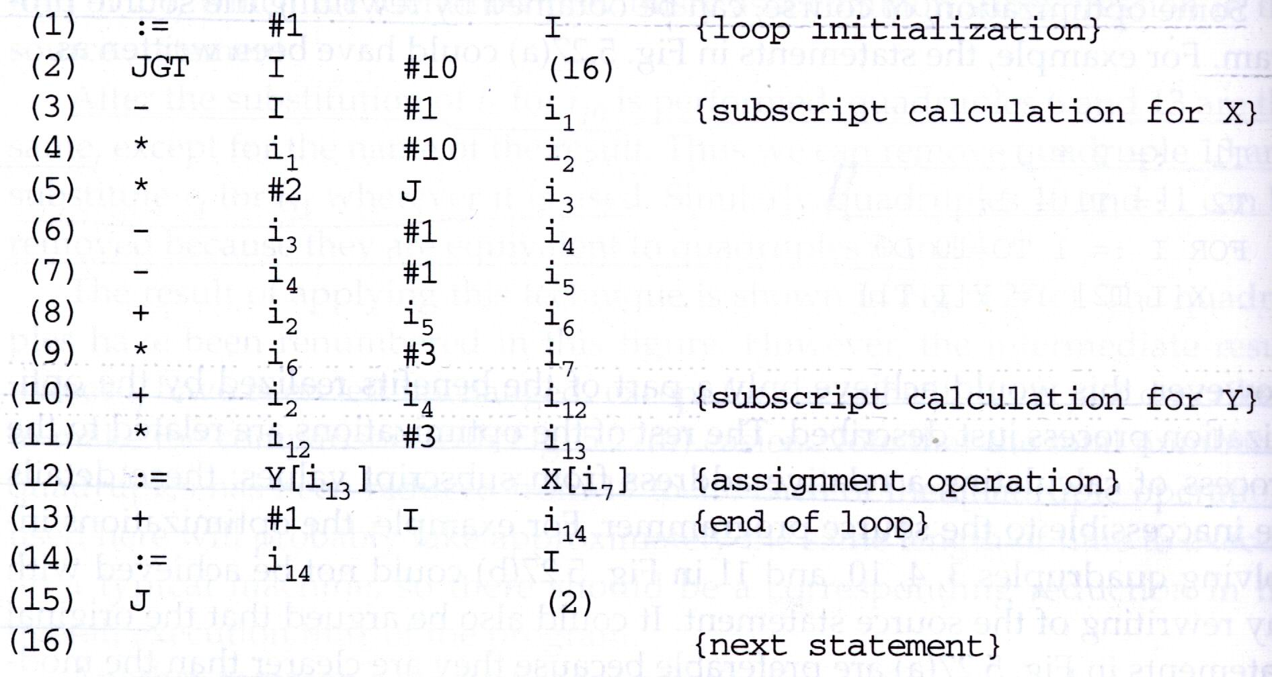
Common Subexpression Elimination

Slide 12
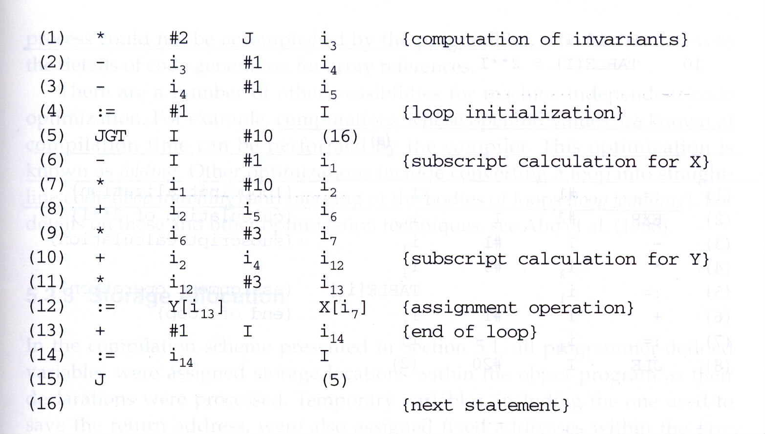
Loop Invariant Elimination

Slide 13
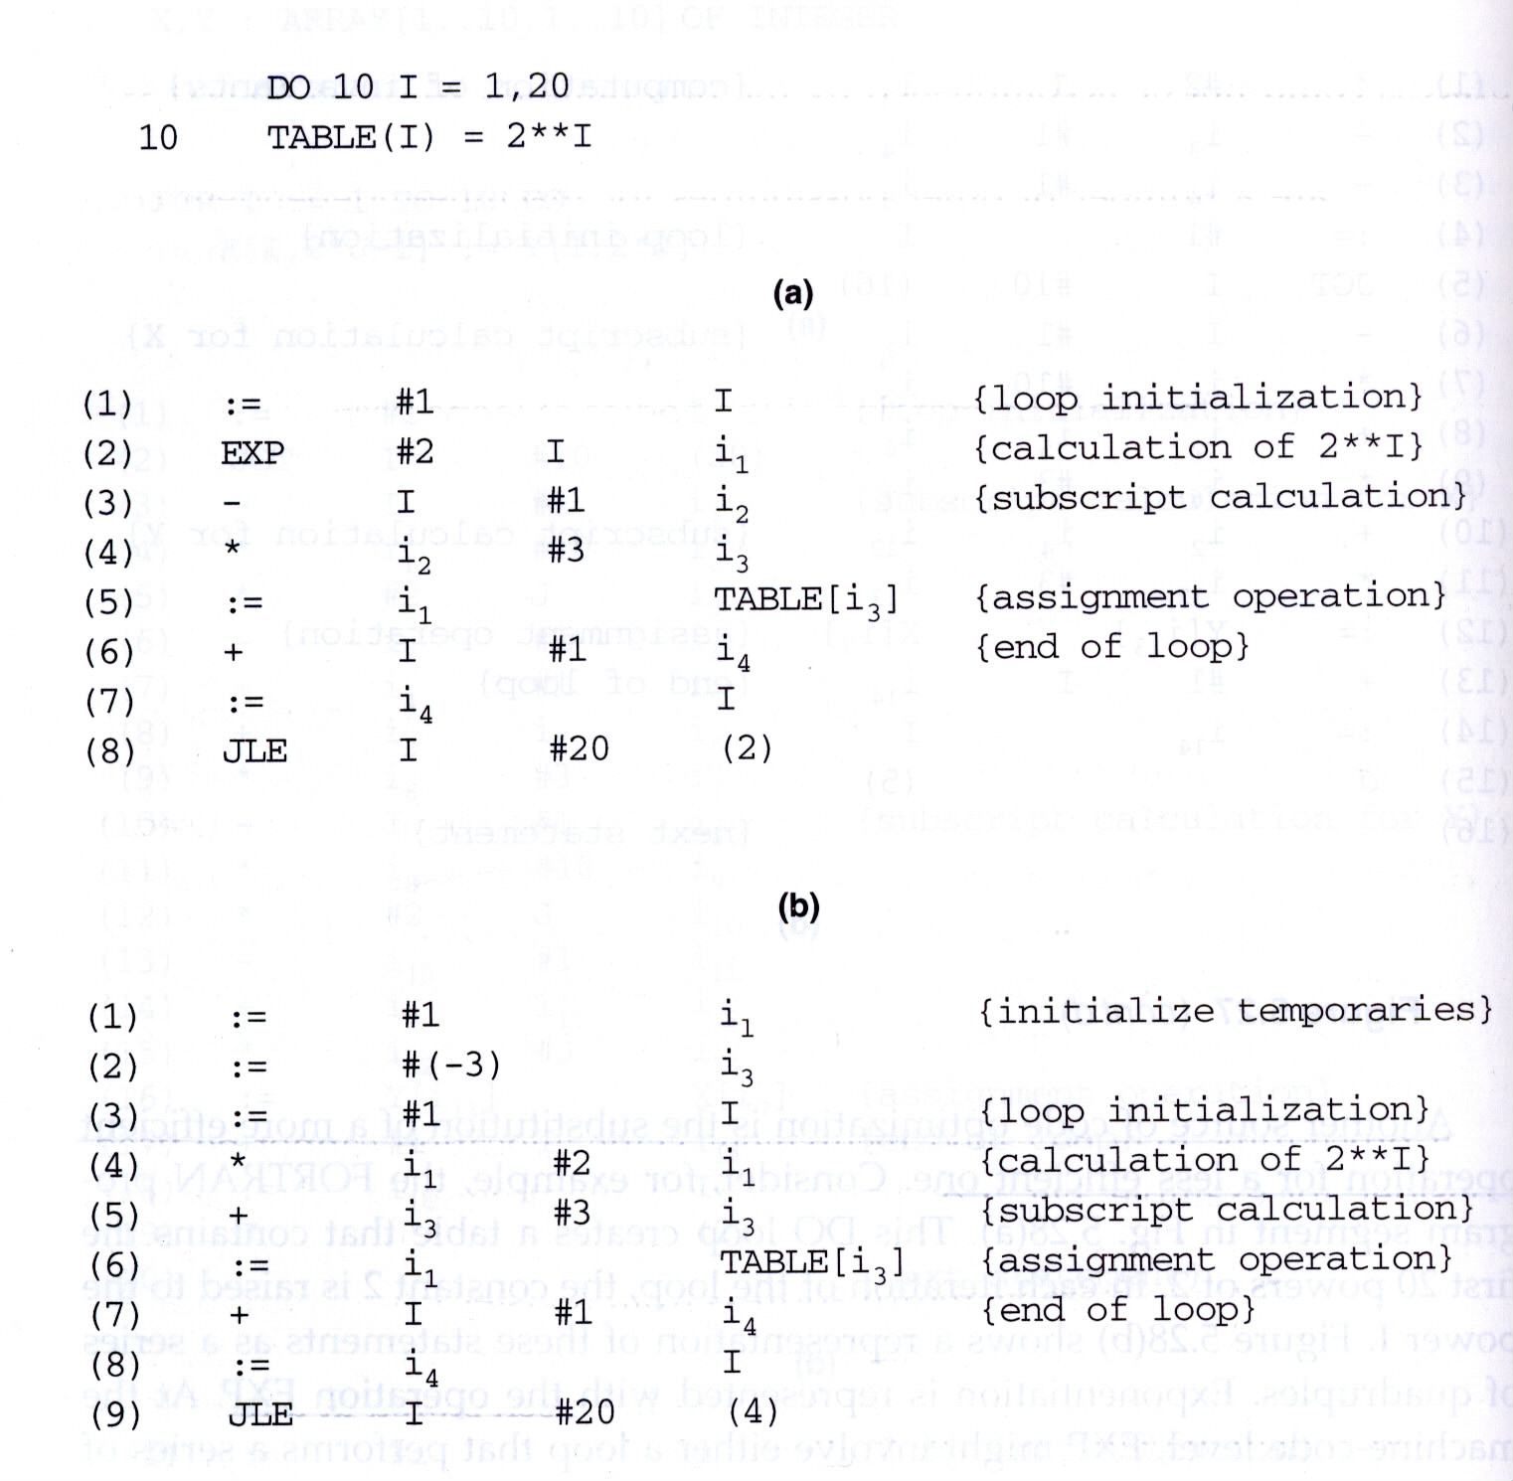
Reducing in Strength of Operations

Slide 14
Code Optimization
Some optimization can be obtained by rewriting the source program, e.g.,
  T1 := 2 * J;
  T2 := T1 – 1;
  FOR I := 1 TO 10 DO
  X[I, T2] := Y[I, T1]
However, this would achieve only a part of the benefits of code optimization.
An optimizing compiler should allow the programmer to write source code that is clear and easy to read, and it should compile such a program into machine code that is efficient to execute.

Slide 15
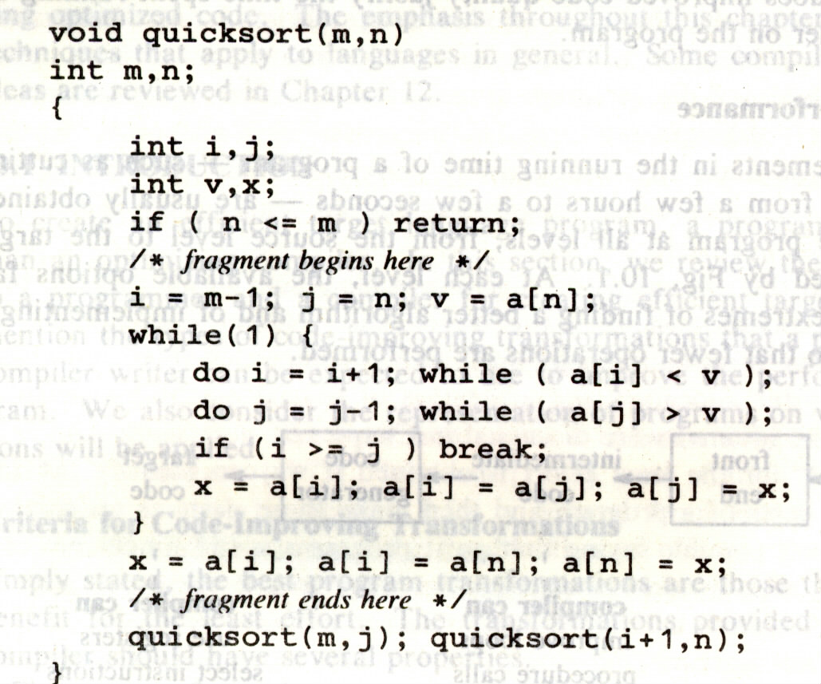
Another Example

Slide 16
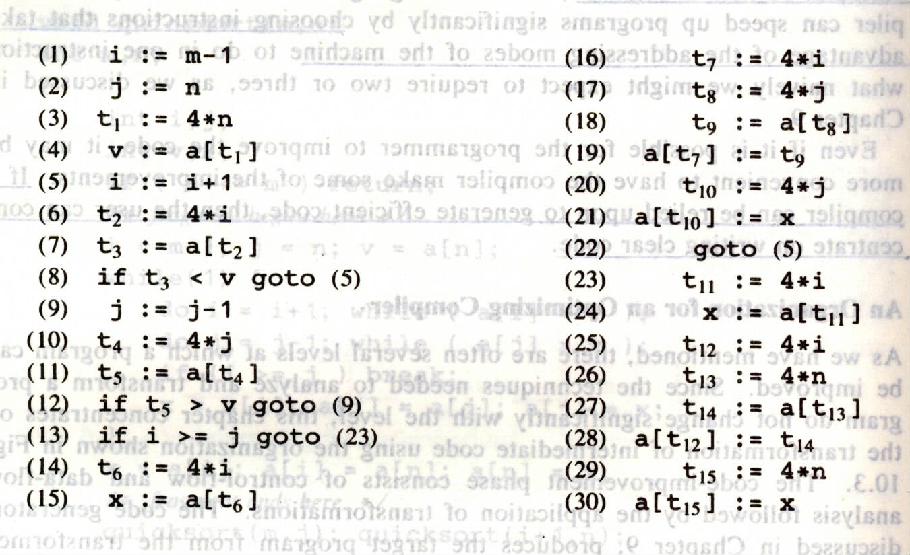
Three-Address Code

Slide 17
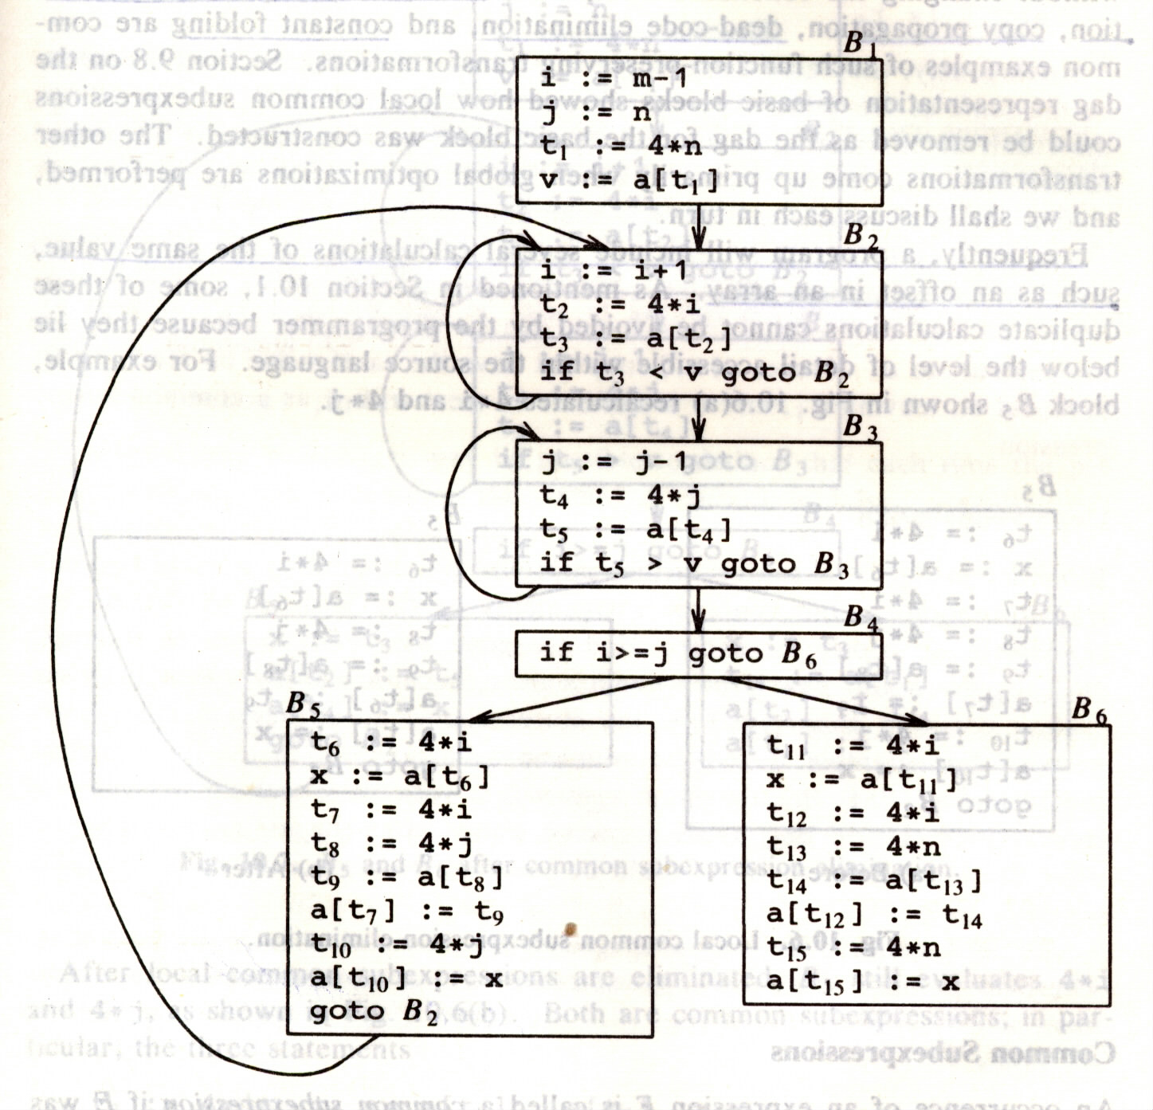
Flow Graph

Slide 18
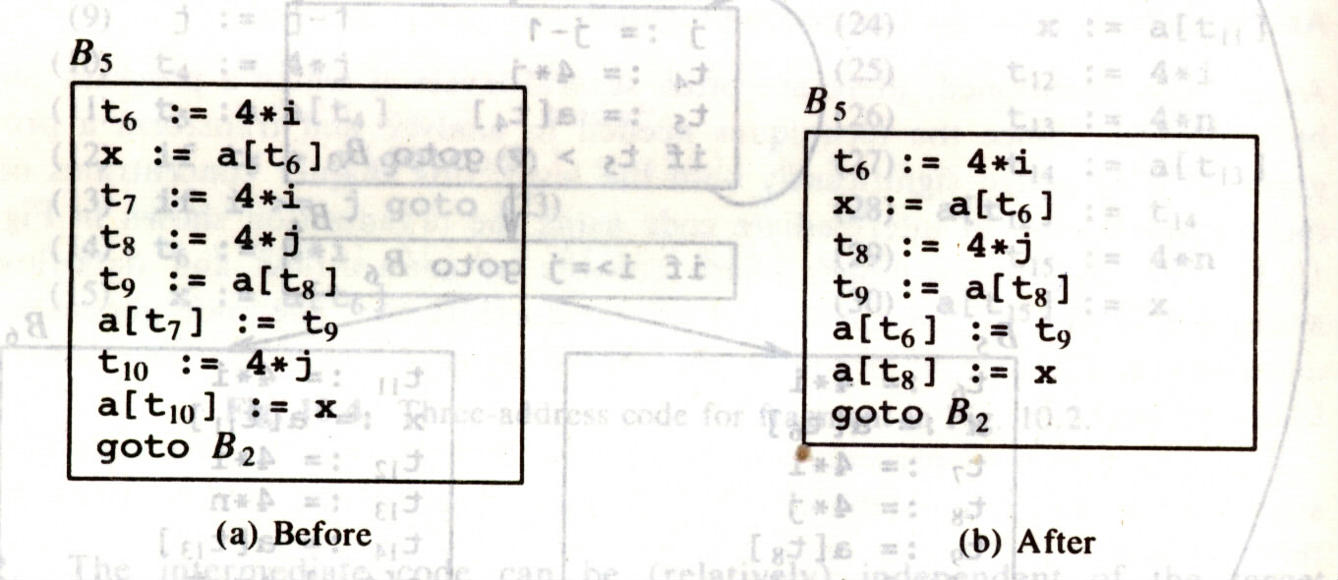
Local Common Subexpression Elimination

Slide 19
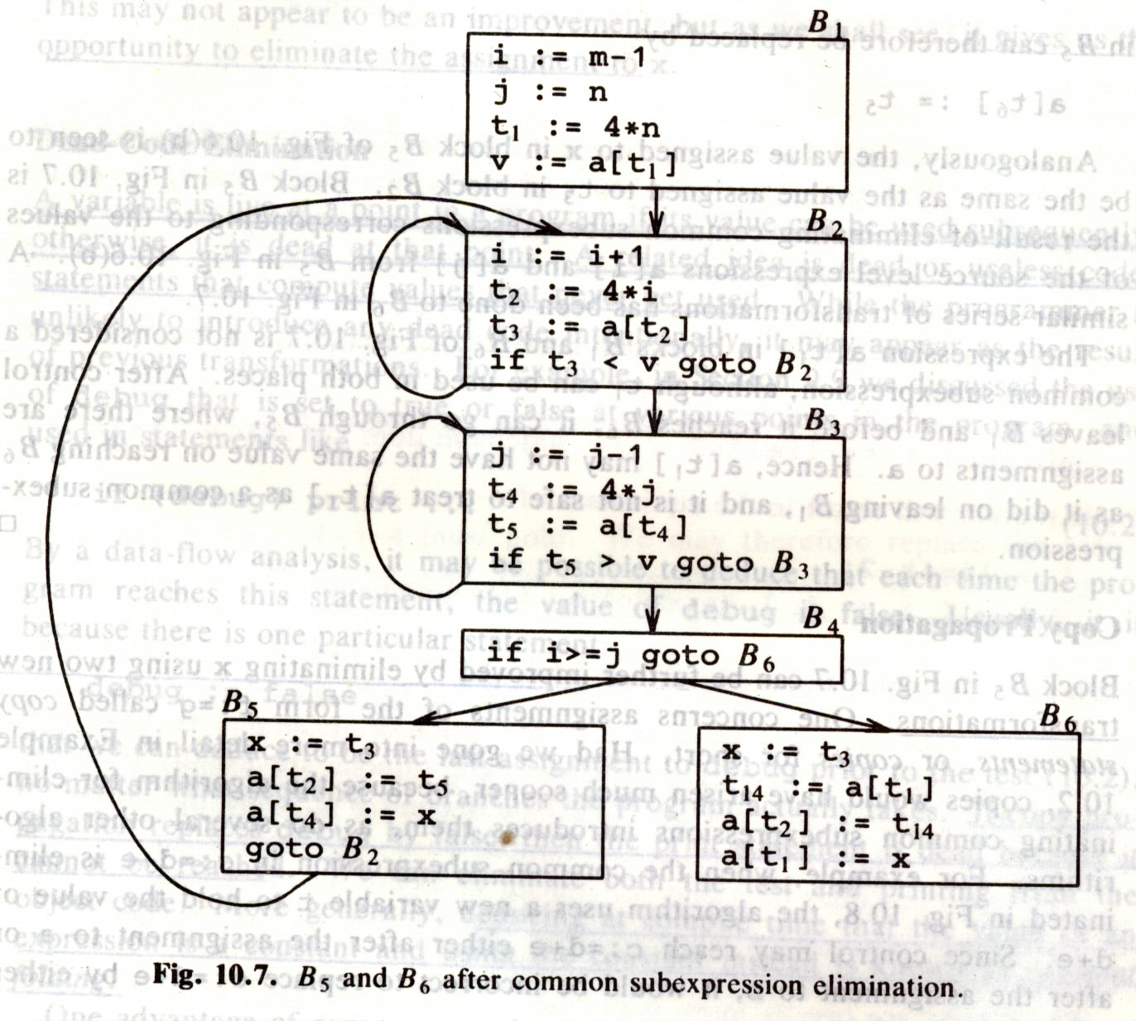
Global Common Subexpression Elimination

Slide 20
Copy Propagation
Improve the code in B5 by eliminating x:
  x := t3
  a[t2] := t5
  a[t4] := t3
  goto B2
The idea is to use g for f, wherever possible after the copy statement
  f:=g
This may not appear to be an improvement, but it gives us the opportunity to eliminate the assignment to x.

Slide 21
Dead-Code Elimination
A variable is live at a point in a program if its value can be used subsequently; otherwise, it is dead (or useless) at that point.
Copy propagation followed by dead-code elimination removes the assignment to x:
  a[t2] := t5
  a[t4] := t3
  goto B2

Slide 22
Loop Optimizations
The running time of a program may be improved if we decrease the number of instructions in an inner loop.
Three techniques are import for loop optimization:
  Code motion
    Moves code outside a loop
  Reduction in strength
    Replaces an expensive operation by a cheaper one
  Induction-variable elimination
    Eliminates variable from the inner loop

Slide 23
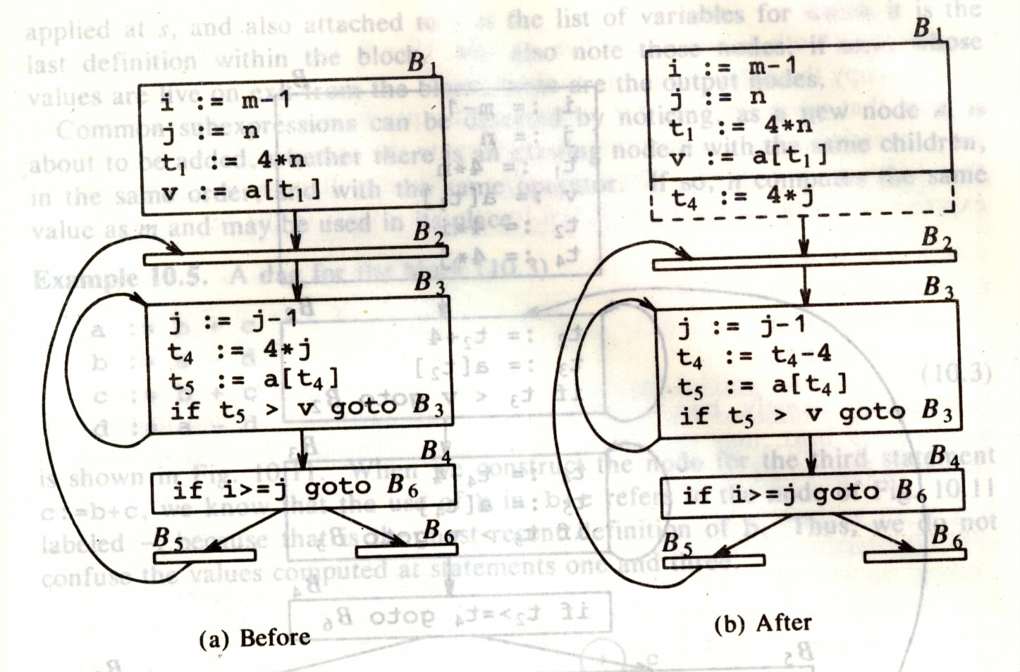
Strength Reduction

Slide 24
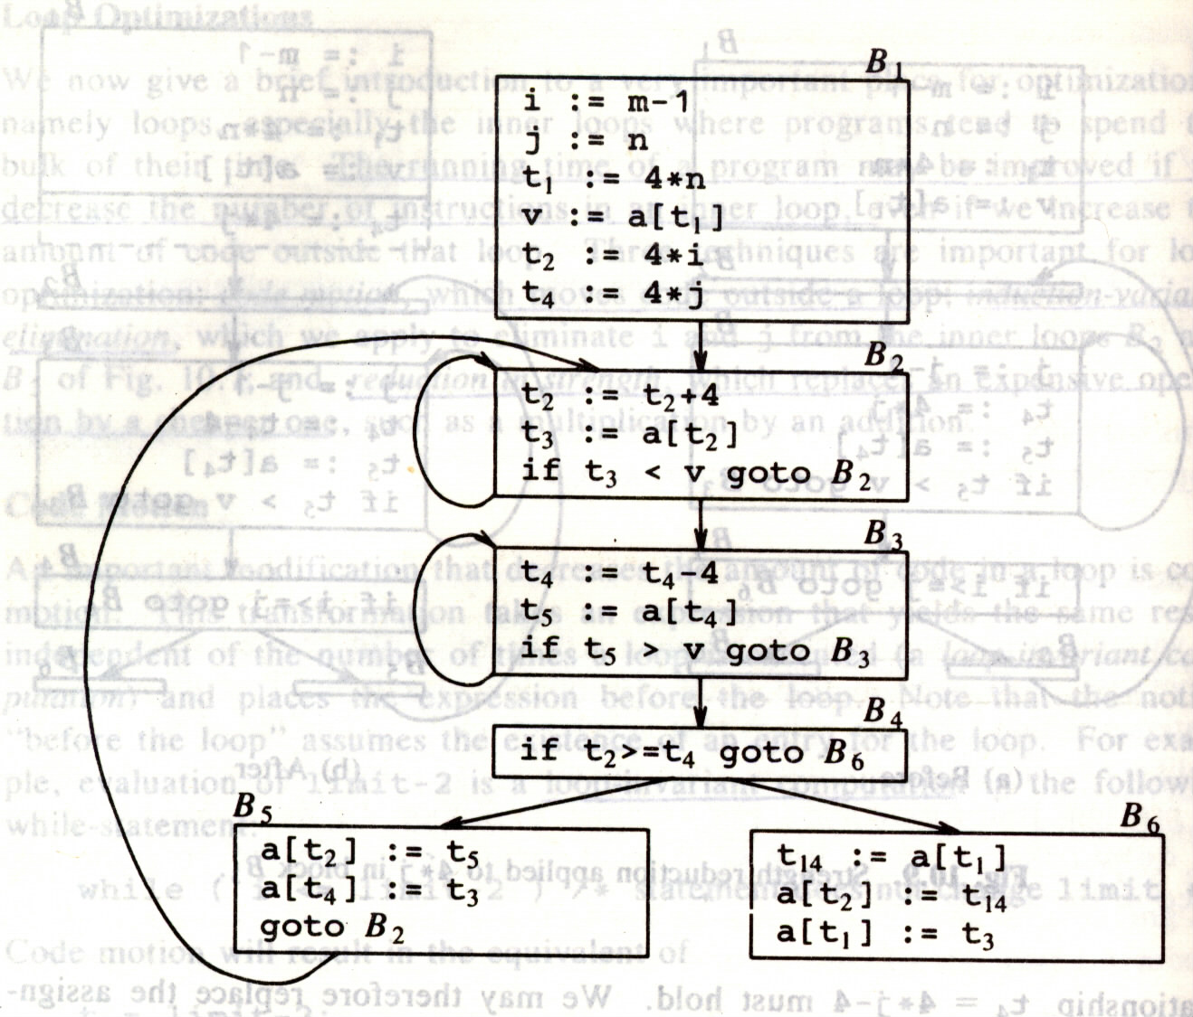
Induction-Variable Elimination
induction variables
induction variables

Slide 25
Code Optimization Result

